Slide 1
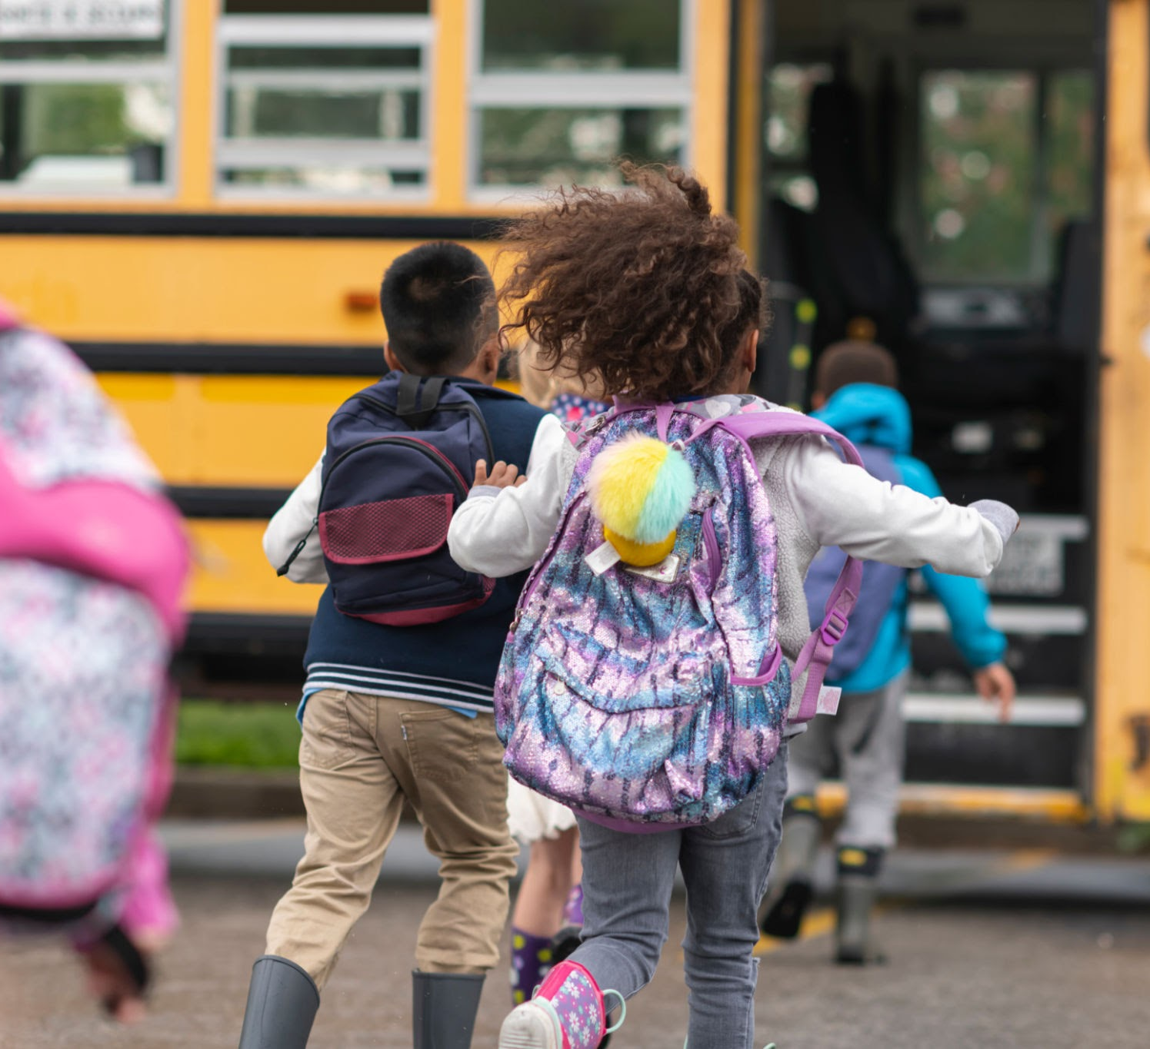
Diversity in the classroom
EDU-401-801
By: Ja’Kobe Hutchison

Slide 2
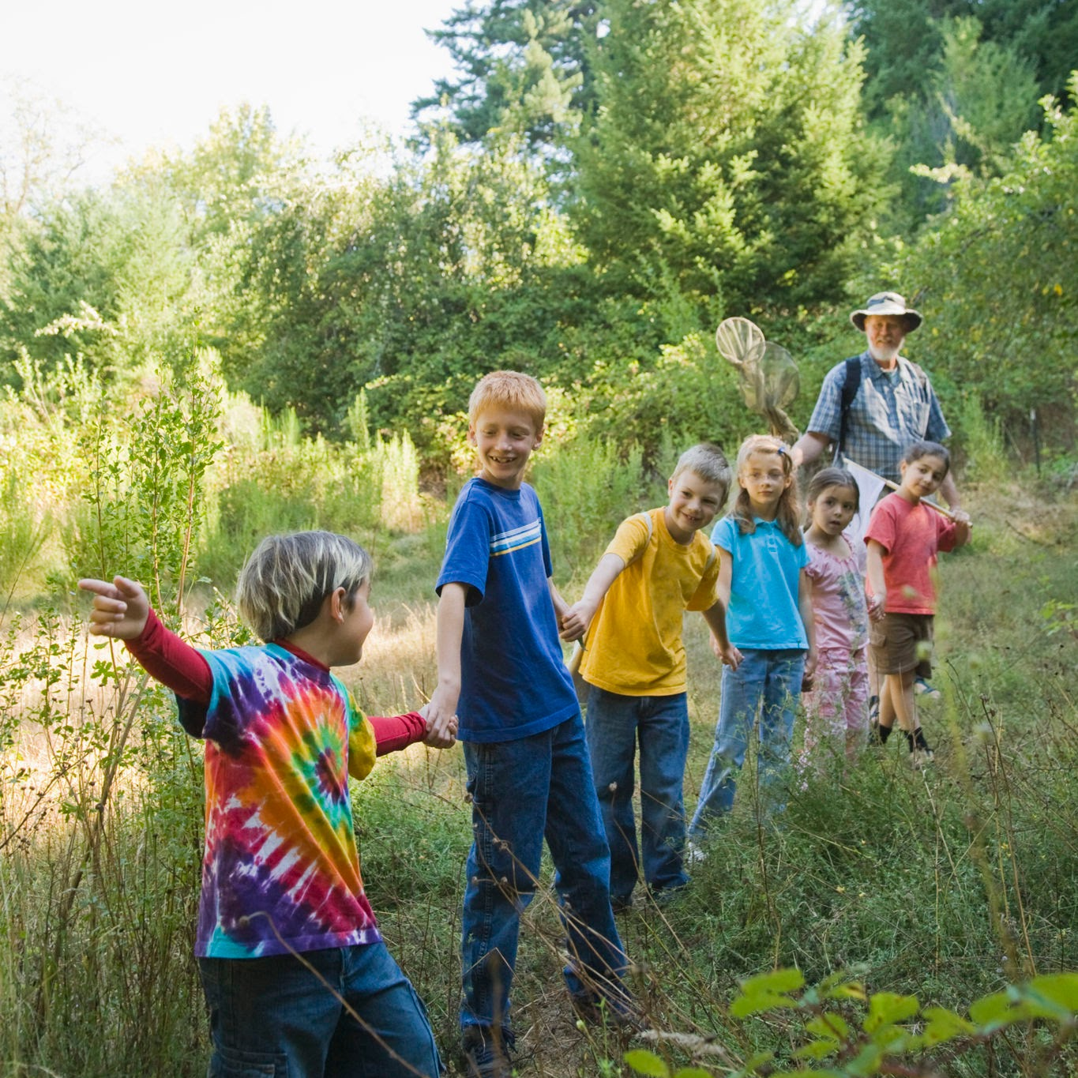
What is diversity
Diversity is the practice or state of including people of different races, cultures, etc in a group or organization
📖

Slide 3
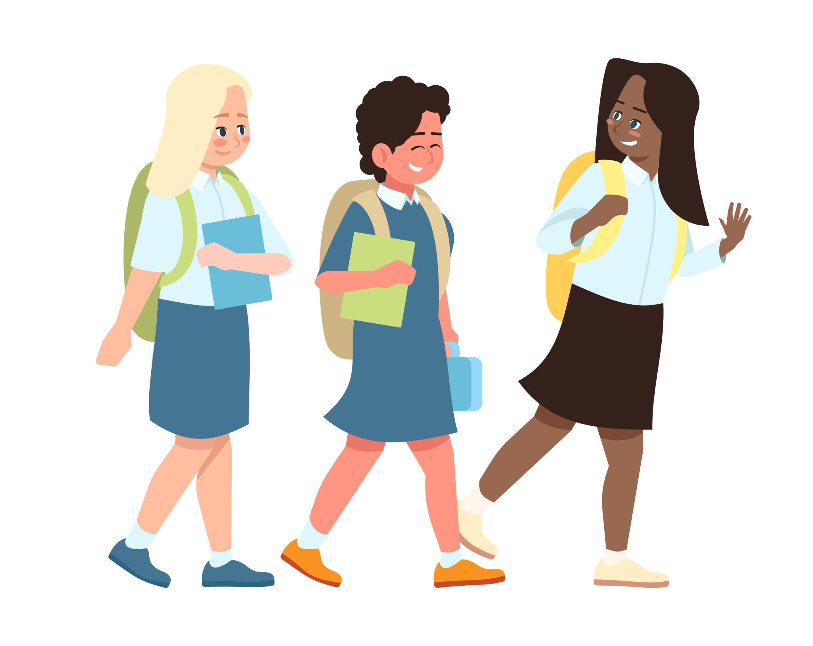
Why is diversity important
Diversity is important becasue it allows for representation and understanding among groups of people
It’s extremely important in the classroom because students should be able to understand despite our differences everybody can learn
🚌

Slide 4
Experience with Diversity
Having taken EDU 114, EDU 258, EDU 260, EDU 390, and EDU 497 I learned a lot about diversity how it can look in the classroom. I also took some EBK classes that explain how early you can start on having and building a comfortable and diverse classroom.
📚

Slide 5
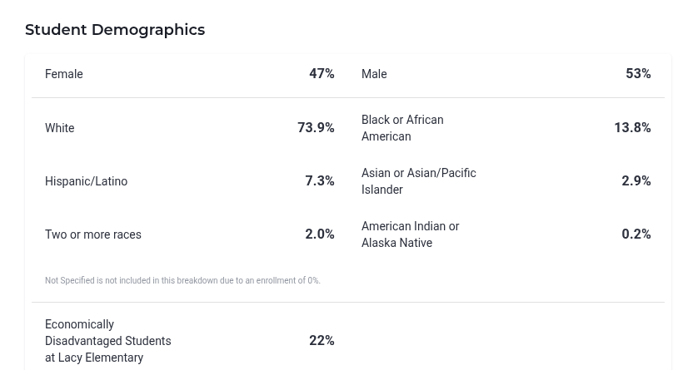
Diversity in Lacy Elementary
The school I attended for my student teaching was Lacy Elementary. I went there for both years of my student teaching. The school is predominantly white with black being the second most common race in the school. It is almost split with male and female, with males making up 53% of the student demographic.
📓

Slide 6
More about Lacy
While the school may not be as diverse as others when it comes to race, they do have a variety of learners in the school. The school has an AIG program for students who score well above their grade level for state testing. The program starts in 3rd grade and allows for students to learn things a grade level or two above their actual grade level.

Slide 7
References
https://www.usnews.com/education/k12/north-carolina/lacy-elementary-217757#students-teachers

