Slide 1
Professional Disposition
Ja’Kobe Hutchison
This powerpoint will become your professional disposition - identifying strengths and areas to improve.
2026

Slide 2
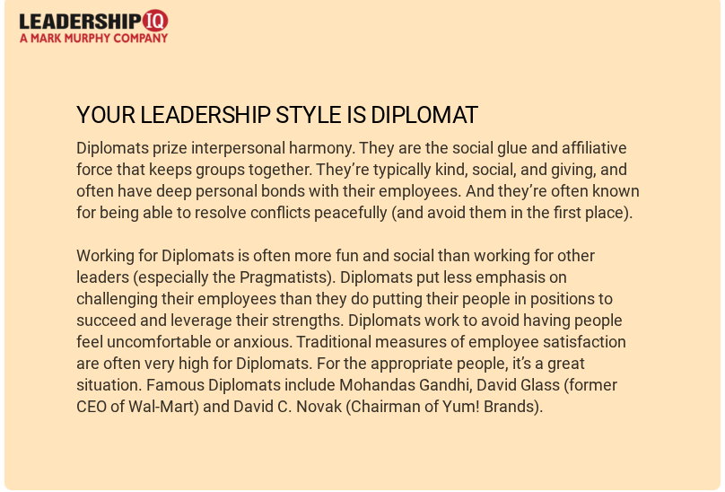
Leadership style
I believe that this leadership style is correct. I do like to give people the option on how they want a task to be done. I also support resolving conflicts peacefully.

Slide 3
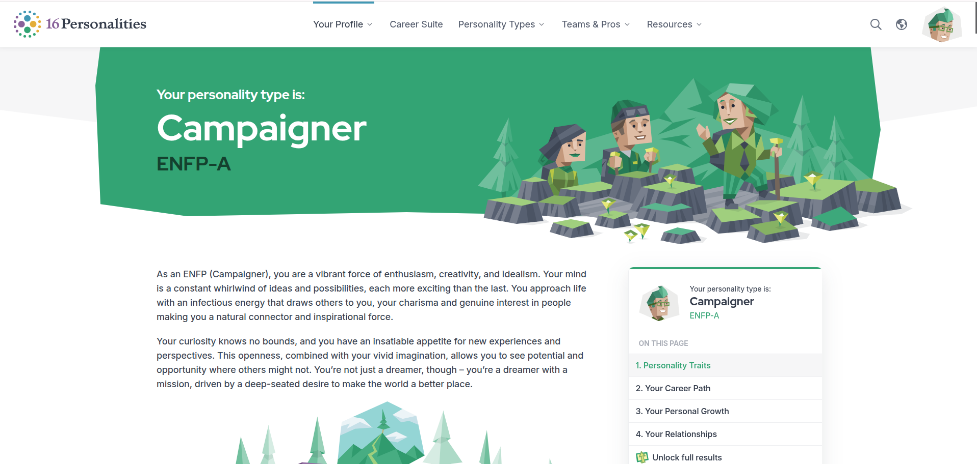
Personality Style
Learning about the campaigner personality definitely opened my eyes to what type of personality I have.

Slide 4
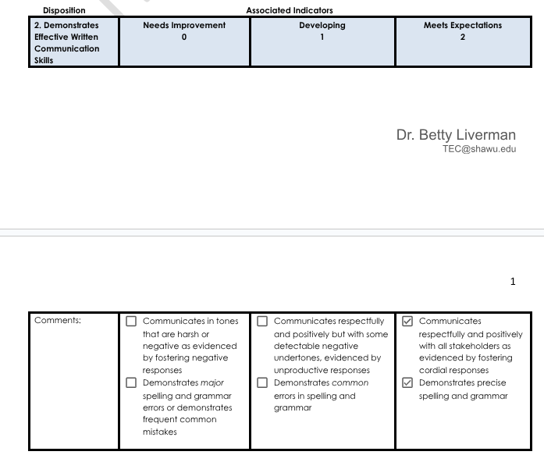
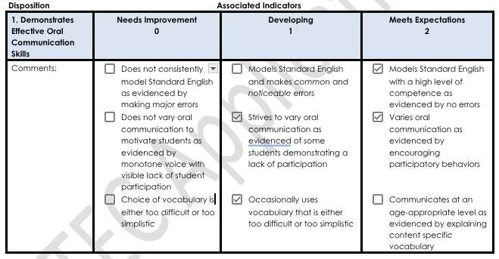
EPDSA
My Educator Professional Disposition Self Assessment. I feel confident in my overall teaching outlook but there are things I need to work on

Slide 5
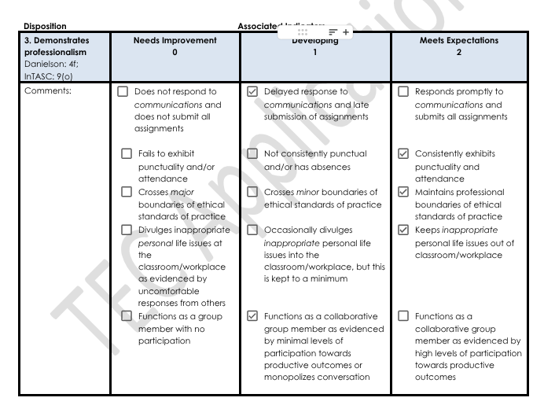
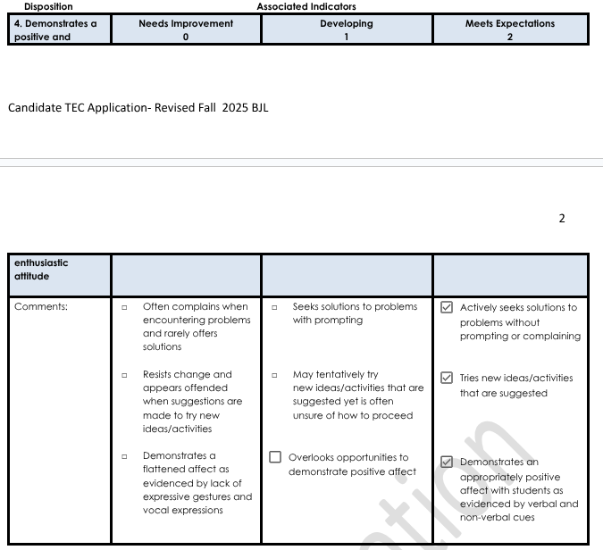
EPDSA

Slide 6
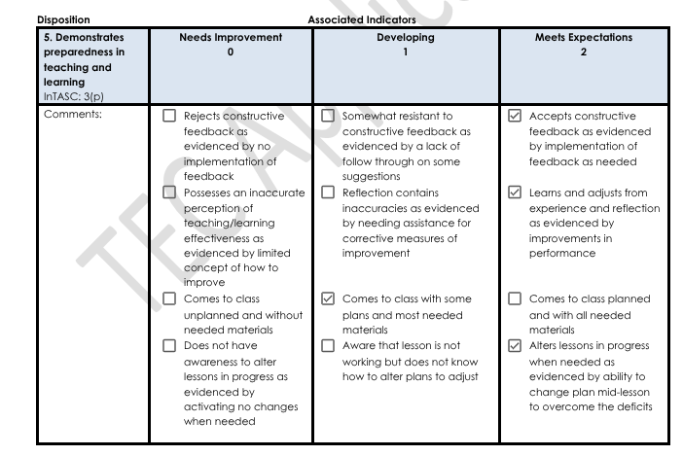
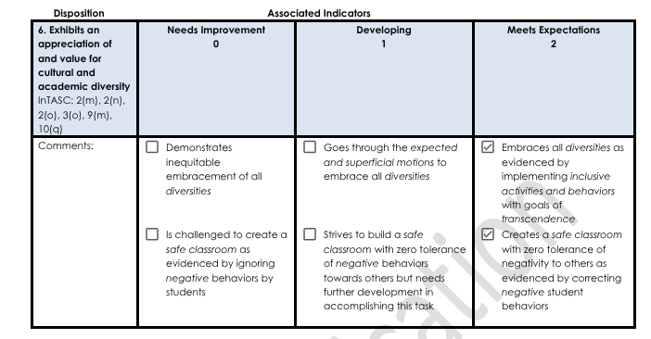
EPDSA

Slide 7
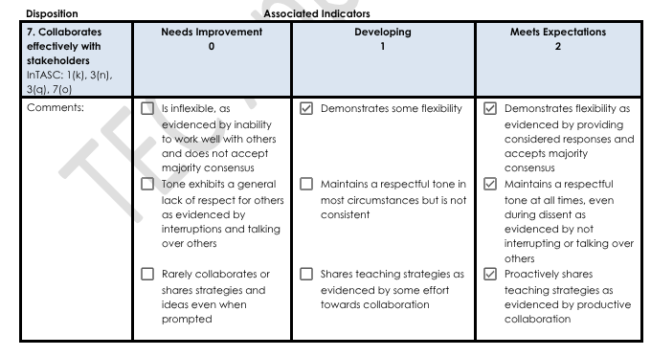
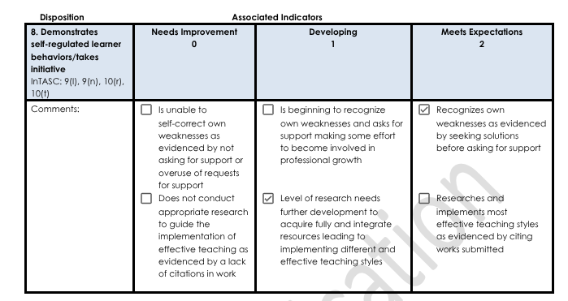
EPDSA

Slide 8
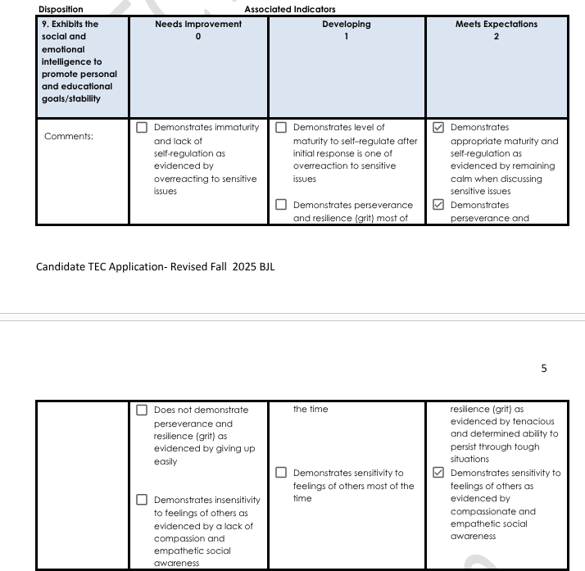
EPDSA

Slide 9
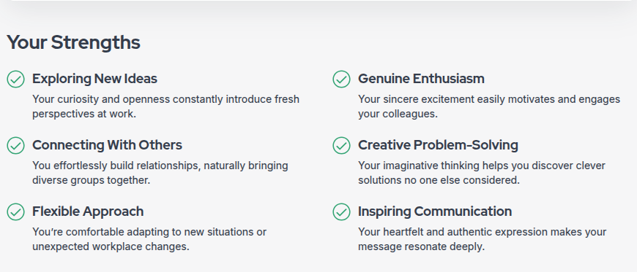
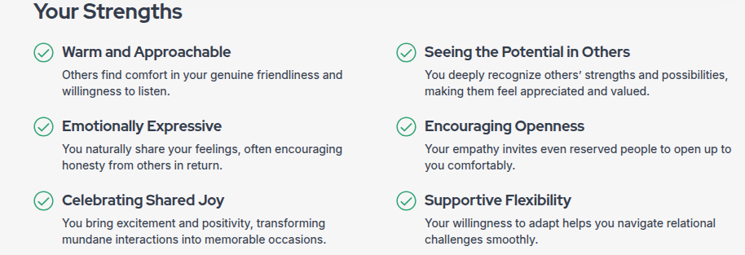
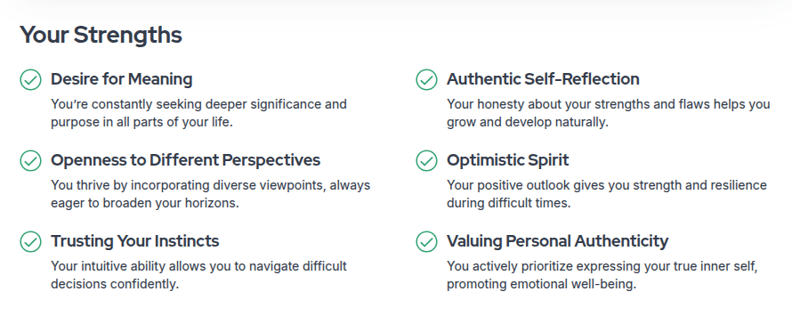
Strengths and areas of weakness
Knowing my strengths and weaknesses can help me become a better teacher. Knowing what I’m strong at can help me re enforce those behaviors and lead to a positive classroom environment

Slide 10
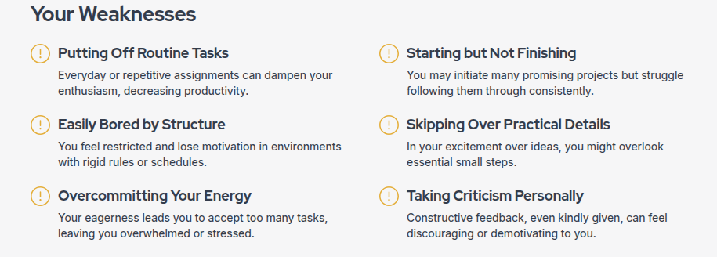
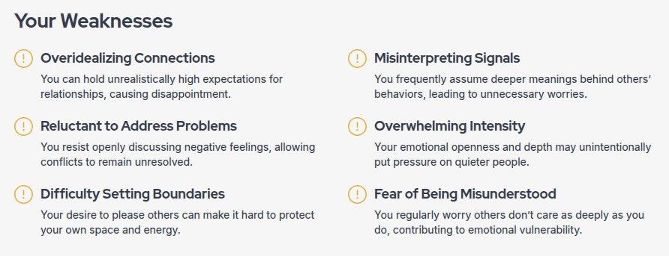
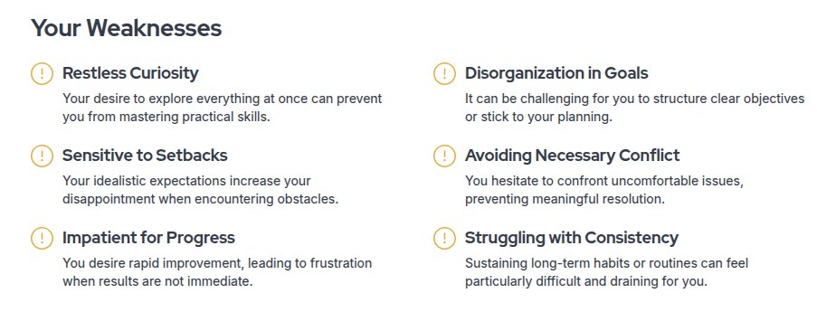
Strengths and areas of weakness
Knowing my weaknesses can also help me become a better teacher. Knowing what I need to work on and improve can only make me a better teacher and person.

Slide 11
Reflection
What skills you will use to facilitate groups successfully? I will use my diplomat leadership style and help create a positive learning environment
What digital tools you will use to assist you as a teacher leader? Learning websites and learning tools can help in the classroom
Based on the findings of yourself, how can you use conflict resolution skillfully? I can use what I know about myself to help solve a problem. I know that I am a person who doesn’t like conflict so knowing how to stop it can help a lot.

Slide 12
Reference Page

